Slide 1

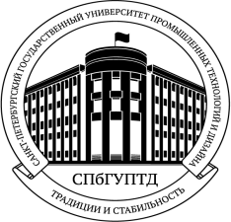
Ministry of Education and Science of Russian Federation
Saint Petersburg State University of Industrial Technologies and Design
(SPbSUITD)
HIGHER SCHOOL OF TECHNOLOGY AND ENERGY
Research & Innovation in the Russian Pulp and Paper
Industry
Prof. Eduard L. Akim,
Honorary Member FAO UN Advisory Committee
on Sustainable Forest-based Industries (ACSFI).
Head of Department.
Akim-ed@mail.ru
Seventy-fourth session of the ECE Committee on Forests and the Forest Industry
18 - 20 October 2016
Geneva (Pala's des Nations)

Slide 2
Russian Pulp & Paper industry
A twenty fife -year delay in the development of the forest sector in the Russian Federation has opened up a unique possibility for implementation of the innovation scenario through the overall reconstruction of existing enterprises on the basis of scientific achievements of the preceding decades, and next-generation techniques and technologies. The most viable way of reconstructing the existing enterprises is the transition to the manufacturing of science-intensive products. For many branches of the forest industries, this approach is the only way to survive under conditions of global competition and free trade.

Slide 3
  BioTex2030 - The Goal & Priorities
Goal: Creation and realization of innovational model of development Russian Pulp and Paper industry, it`s scientific and public development.
Priorities:
1.Fundamental reconstruction of the existing pulp and paper enterprises with the establishment of enterprises for the integrated wood processing on the basis of bio-refinery principle in the region of tree growth.
2. Production of knowledge-intensive products with high added value in the region of tree growth on the basis of deep processing of raw materials – wood of all tree species.
3. Realization of bio-refinery, usage of lignin & hemicelluloses as raw materials and components of composite, resin for plywood, OSB, LVL and others.

Slide 4
Russia Forests - Main Tree Species (mln. Ha)
Коренная реконструкция существующих ЦБК, с созданием на их основе непосредственно в регионе произрастания древесины предприятий комплексной (integrated) глубокой переработки древесины по принципу био-рефайнери (biorefinery),
оптимизация лесосырьевой структуры ЦБП, устойчивое лесообеспечение ЦБК на базе сочетания интенсификации лесопользования и плантационного выращивания быстрорастущих пород (в том числе, с созданием питомников на площадях внеплощадочных очистных сооружений и утилизацией тепла очищенных сточных вод), Оптимизация структуры волокнистых полуфабрикатов ЦБП, расширение использования вторичных волокон (макулатуры),

Slide 5
Siberian larch (Larix sibirica) and Dahurica larch (Larix dahurica Turcz)
The Siberian larch (Larix sibirica) and Dahurica larch (Larix dahurica Turcz) are widely spread in western, central and trans-Ural Russia and may have practical applications not only as renewable cellulose-containing raw material, but also as a source of other biologically active polysaccharides. The presence of large amounts of arabinogalactan (AG) in larch wood (up to 30 wt%) necessitates developing complex waste-free technology of larch wood processing. This technology should allow obtaining purified wood pulp along with AG and other water-soluble hemicelluloses on an industrial scale.

Slide 6
The “Larch” project: «Development of innovative technologies for complex processing of larch wood with conclusion a new kind of pulp on the world market».
It is a first real example of public-private partnership in the Russian pulp and paper industry - a joint project of JSC “Ilim Group” and the St. Petersburg State Technological University of Plant Polymers.
The project is designed for 2010-2014, with total project cost about U.S. $ 10 million(over350 million rubles. State support (#218) - 150 million rubles, Private (ILIM Group) - 200 million rubles).

Slide 7
Major Russian Pulp, Paper & Board Producers 2015 (2014)
 | Total Output, x 000 t | Market Pulp, x 000 t | Paper, x 000 t | Board, x 000 t
Ilim Group: | 3127 (2951) | 1981 (1846) | 473 (454) | 673 (651)
Kotlas | 905 (945) | 289 (299) | 473(454) | 487 (471)
Bratsk | 744 (734) | 896 (743) |  | 186 (180)
Ust-Ilimsk | 707 (721) | 796 (804)
Arkhangelsk | () | 235(217) | 80(73) | 463 (485)
Syktyvkar | () | 114 (36) | 718(723) | 253 (274)
Svetogorsk | () |  | 377 (384) | 104 (101)
Segezha | () |  | 267(254) | ()
RUSSIA | 10510 10059) | 2494 (2259) | 4954 (5041) | 3062(2759)
Ilim Group % | 29,8 (29,3) | 79,4 (81,7) | 9,5 (9,0) | 22,0 (23,6)

Slide 8
Larch Project
Larch Project can be considered as innovative component of the priority investment projects currently implemented by OJSC Ilim Group, Big Bratsk Project in particular. Innovative aspect of this Project lies in creation of a conceptually new innovative technology for bio-refining and integrated processing of larch wood, and launching new types of products in the global markets.
The technology is developed based on the principles of information technology, nanotechnology, and biotechnology.

Slide 9
Innovative R&D organization methods
Innovative R&D organization methods involve used:
of the public-private partnership mechanism,
simultaneous implementation of fundamental, engineering, and R&D efforts,
special-purpose development of laboratory facilities,
transition from laboratory research to trial runs at manufacturing facilities,
system analysis of the current state of and trends in global markets both in
pulp and paper and related industries.
These methods also imply integration of the research potential of Russian
universities (2) and research institutes (11) with the potential of foreign researchers and engineers, including Russian researches working abroad;
utilization of latest technology laboratory equipment at the domestic and international research centers;
broad utilization of the potential of university students (90), post-graduates (9), and young scientists.

Slide 10
Information technology, Bio-technology & Nanotechnology
Information technology is used for development of geo-information systems which receive and process data from satellites on actual larch resources, and for development of the most effective harvesting logistics based on the principles of sustainable forest management.
Bio-technology involves application of targeted control of processes such as biodestruction, chemical reactions, and mechano-chemical reactions in combination with membrane methods for concentration and separation of non-fiber polysaccharide larch components, and combination of these methods with separation of multi-component systems by flotation.
Nanotechnology is used to develop a scientifically proven technology to extract from larch wood its key component – arabinogalactan – which is localized in the nanostructure of larch wood. Biotechnology is used to create a commercial biorefining technology

Slide 11
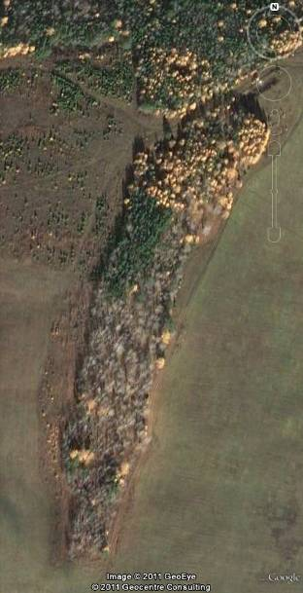
Geographic Information System of Satellite Forest Resource Monitoring in Framework of Project “Larch”
It is shown that to obtain relevant information about the state of forests the most effective way is to use remote sensing data. Method of decoding data from the satellite SPOT (France) was developed to determine the species composition of forest stands. Introduction of new information technologies, combined with modern features remote sensing space systems of the Earth will be a significant step in providing reliable information on forest areas, to assess the growing stock and species composition and obtain the necessary data to determine the stock of larch. The data obtained can be used in carrying out the project “Larch”.
Larch
Spruce
Birch

Slide 12
Scientific results
It was found that arabinogalactan located in the wood has liquid state - as aqua-complex «arabinogalactan-water».
This state gives opportunity to extract this complex from wood easy.

Slide 13
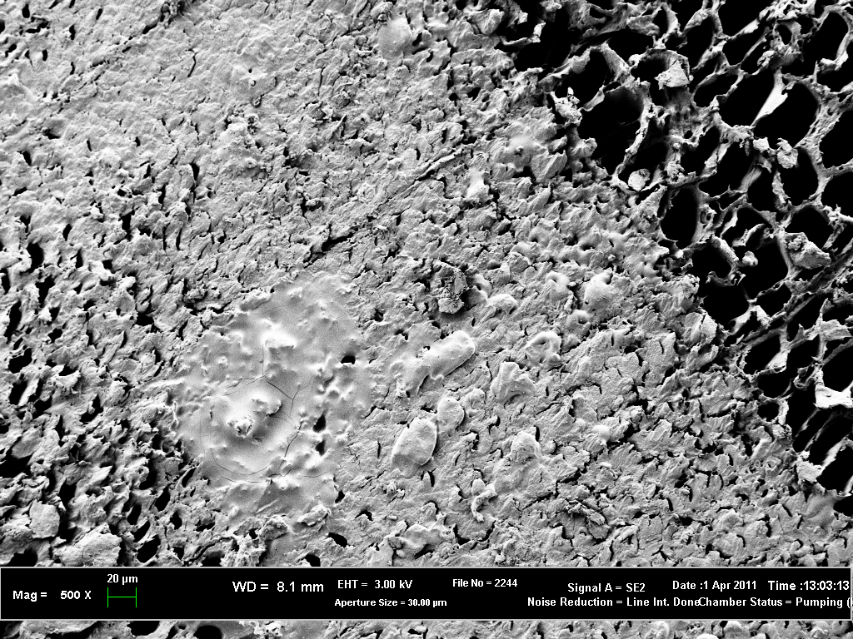
Arabinogalactan “films” on the surface of Wood

Slide 14
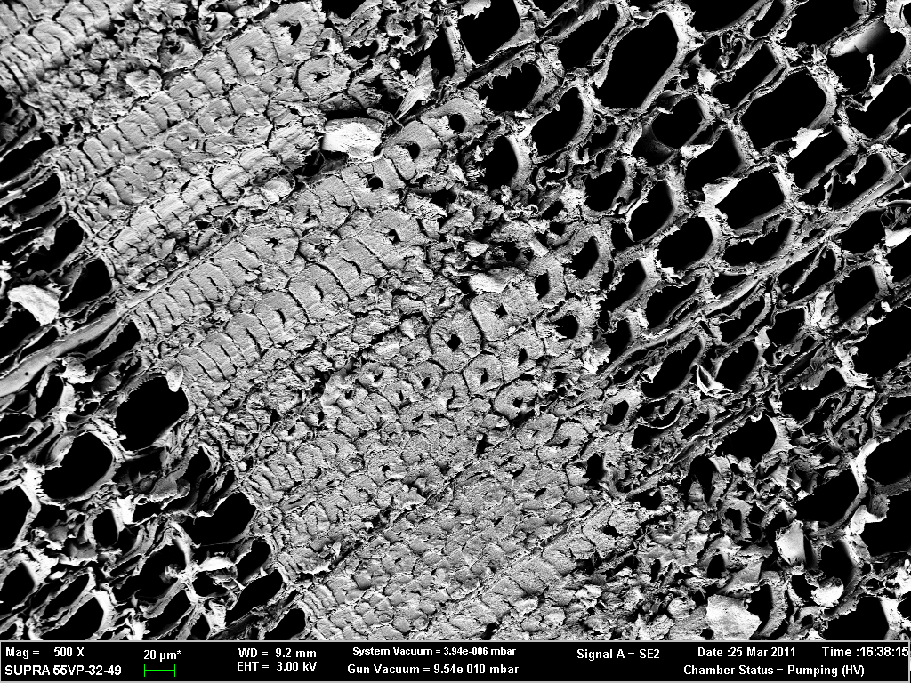
Теоретические основы инновационной технологии комплексной переработки древесины лиственницы базируются на исследованиях нано-структуры древесины и ее полимерных компонентов, путей направленного изменения нано-структуры.
Теоретический анализ места наноструктур в многоиерархической надмолекулярной и морфологической структуре целлюлозы и древесины лиственницы, в том числе классификацию уровней нано-структуры;
Выявление роли основных элементов нано-структуры древесины и целлюлозы: кристаллических и аморфных областей, микрофибрилл и фибрилл, капиллярно-пористой структуры (КПС) древесины, полупроницаемых мембран, надмолекулярных образований экстрактивных веществ древесины лиственницы (арабиногалактан, смолы и др.);
Теоретический анализ роли релаксационного состояния аморфных областей полимерных компонентов древесины, как важнейшей составляющей ее нано-структуры, на всех стадиях жизненного цикла деревьев и древесных продуктов, включая целлюлозу, бумагу и композиты на их основе.

Slide 15
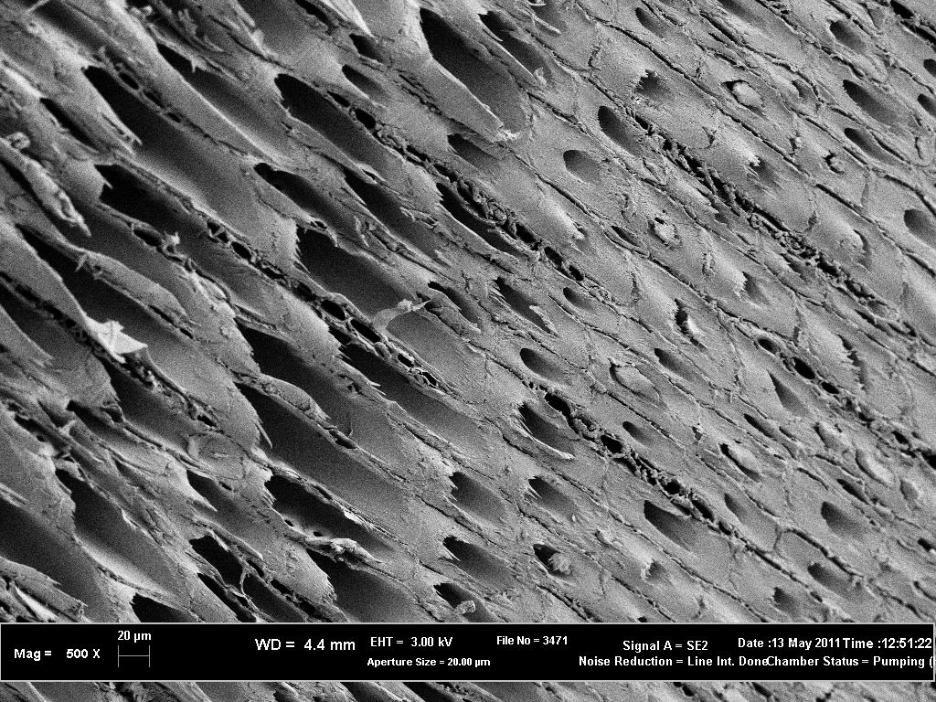

Slide 16
Process solutions based on larch wood properties
High content of arabinogalactan in pulpwood (10-30%) means that it must be extracted before cooking.
High water solubility of arabinogalactan provides for its efficient extraction.
Following the extraction of arabinogalactan, the chips can be used to manufacture market pulp, dissolving pulp and pulp intended for sanitary and hygiene products.

Slide 17
Methods for extracting arabinogalactan from chips
Water extraction of arabinogalactan.
Water extraction with high pH
Steam extraction.
Black liquor extraction of arabinogalactan.

Slide 18
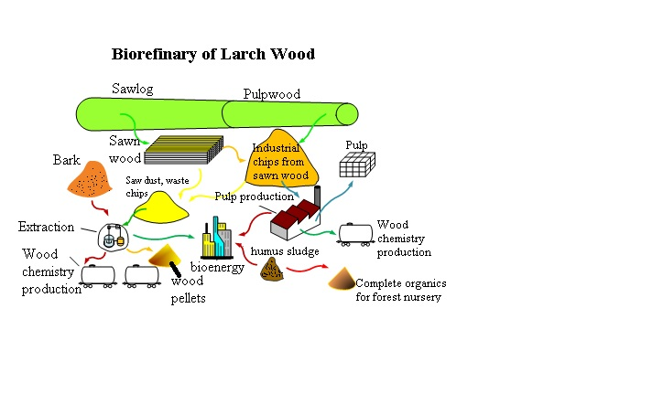

Slide 19
Practical results
In 2014 new innovative technologies for complex processing of larch wood was realized on the Bratsk Pulp & Paper mill.
In 2014-2016 years on new innovative technologies was produced 1 000 000 tons market pulps; 90% - for export.
This innovative technologies based on 19 patents RF (www.freepatent.ru ).

Slide 20
International aspects
The Project will take advantage of:
the technology platforms mechanisms both in Russia and abroad;
cooperation with international institutions such as the UN (UNECE, FAO);
cooperation with nongovernmental organizations (ICFPA).

